Slide 1
Priors: (0,0)
T = 200, n=50
No covariance (off-diagonals)

Slide 2
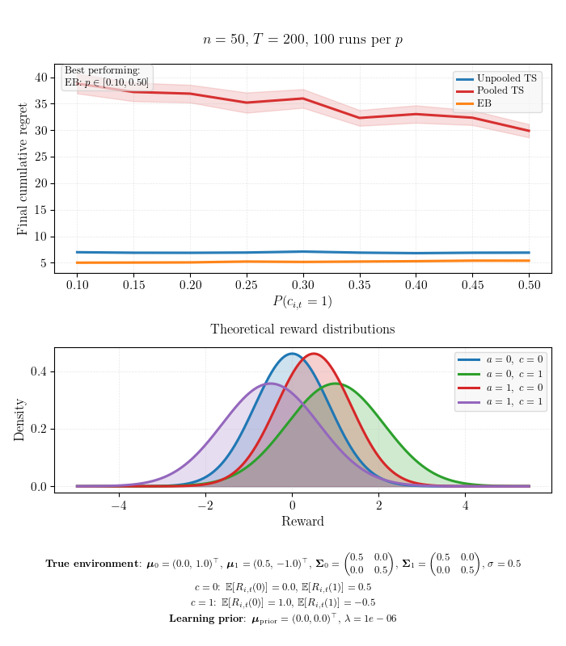
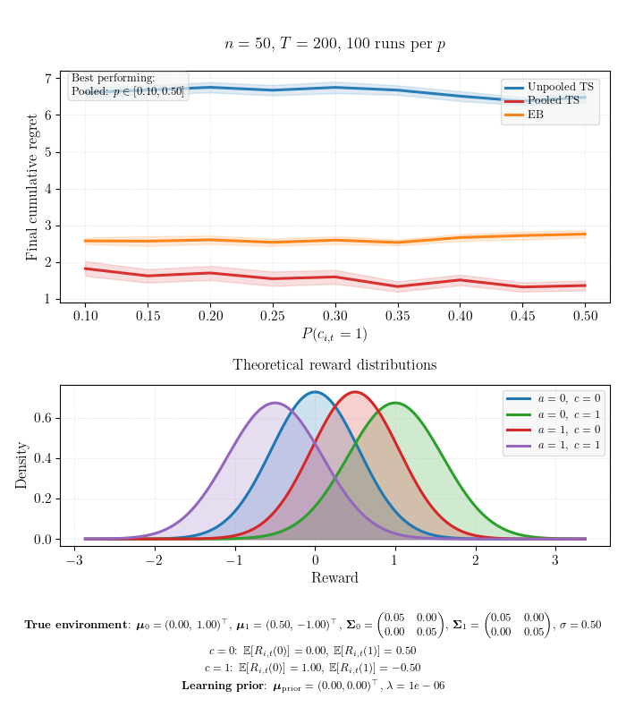
Optimal arm differs moderately by context
High heterogeneity-to-noise ratio (0.5/0.5)
Low heterogeneity-to-noise ratio (0.05/0.5)

Slide 3
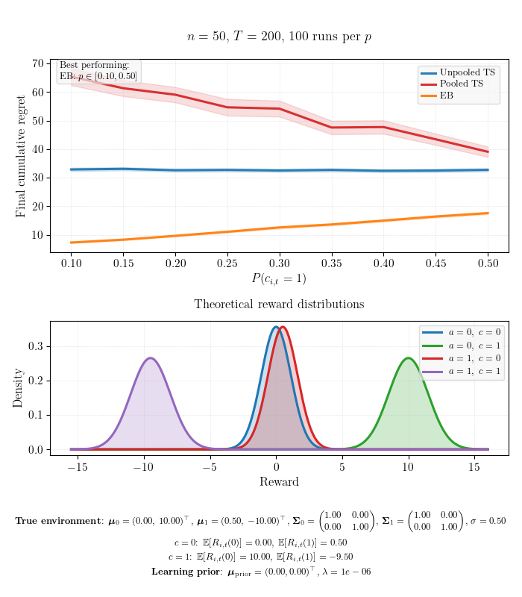
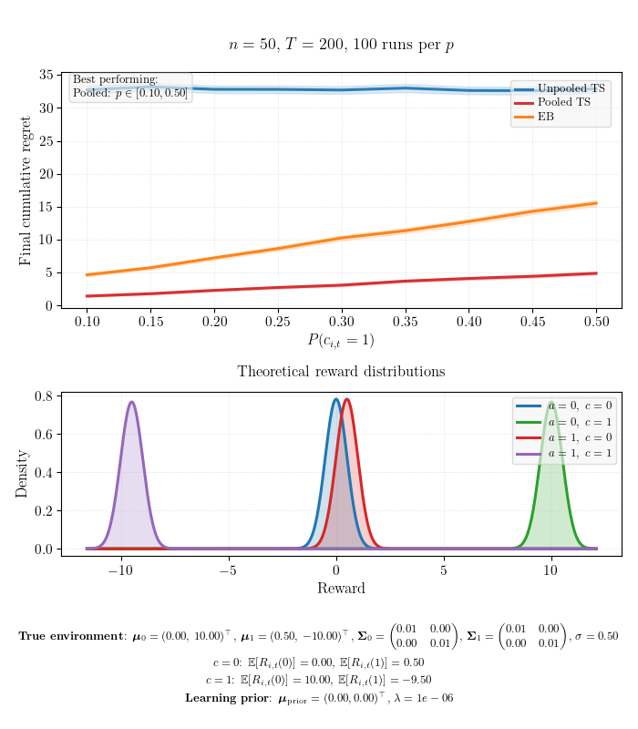
Optimal arm differs extremely by context
High heterogeneity-to-noise ratio (1/0.5)
Low heterogeneity-to-noise ratio (0.01/0.5)

Slide 4
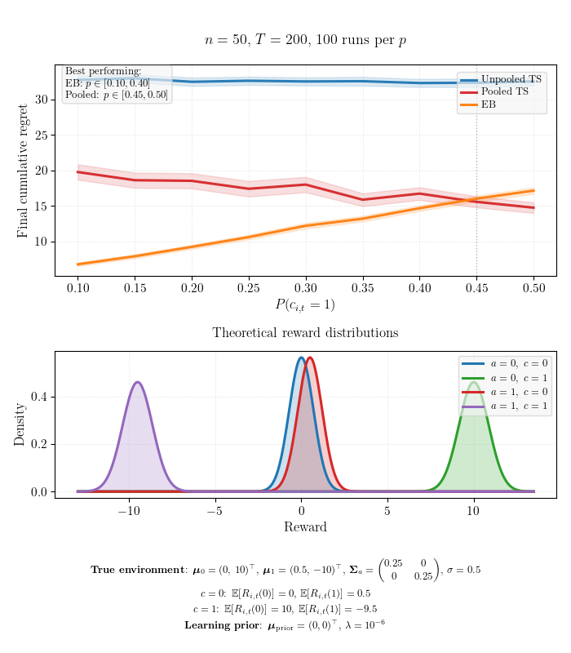
Optimal arm differs extremely by context
Moderate heterogeneity-to-noise ratio (0.25/0.5)

Slide 5
Additional Settings

Slide 6
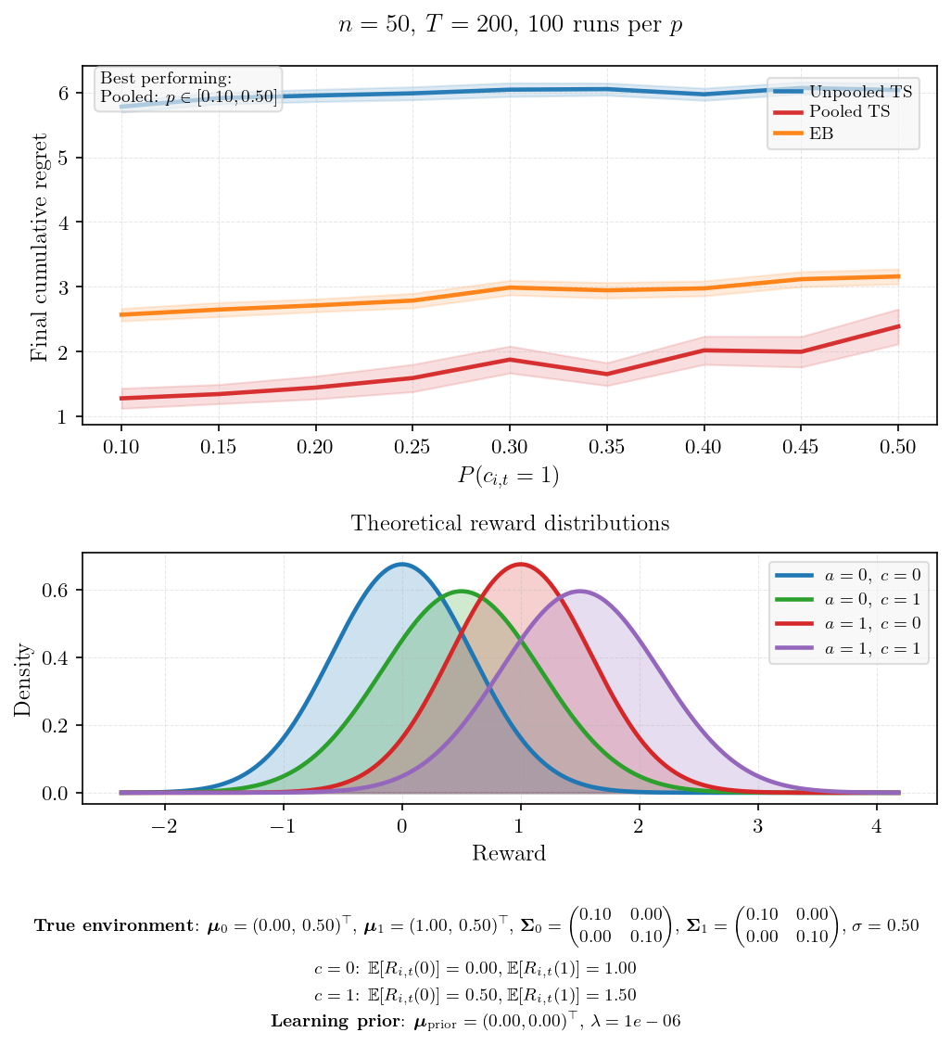
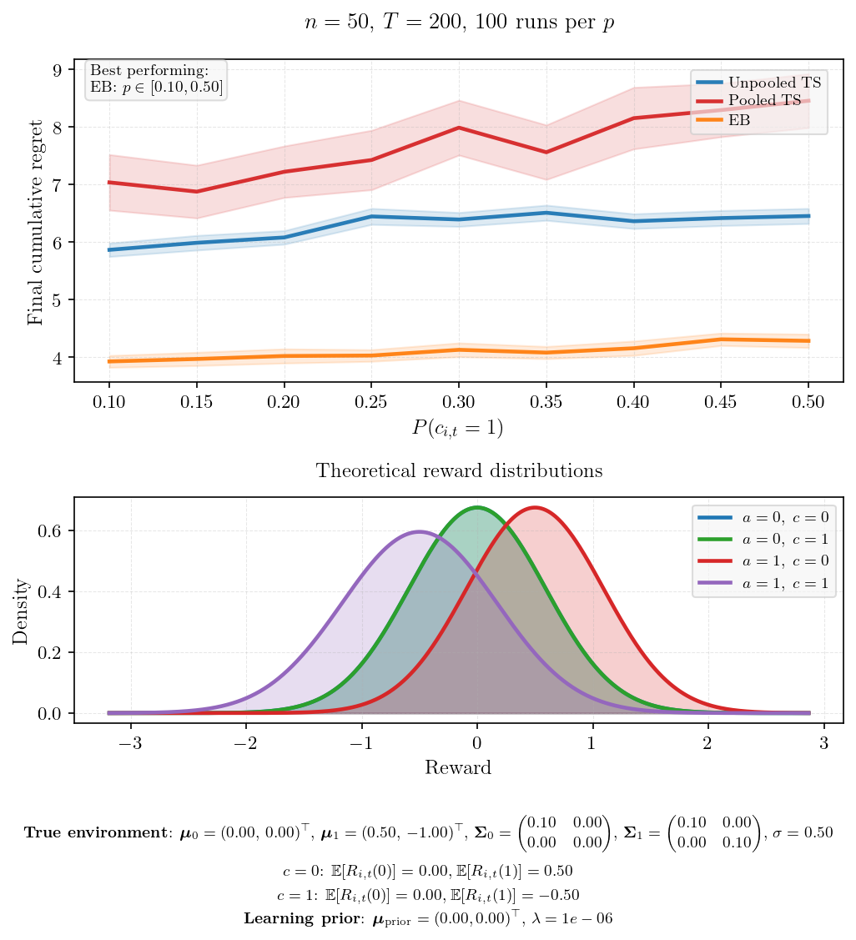
Optimal arm never flips
Context coefficient zero for one arm

Slide 7
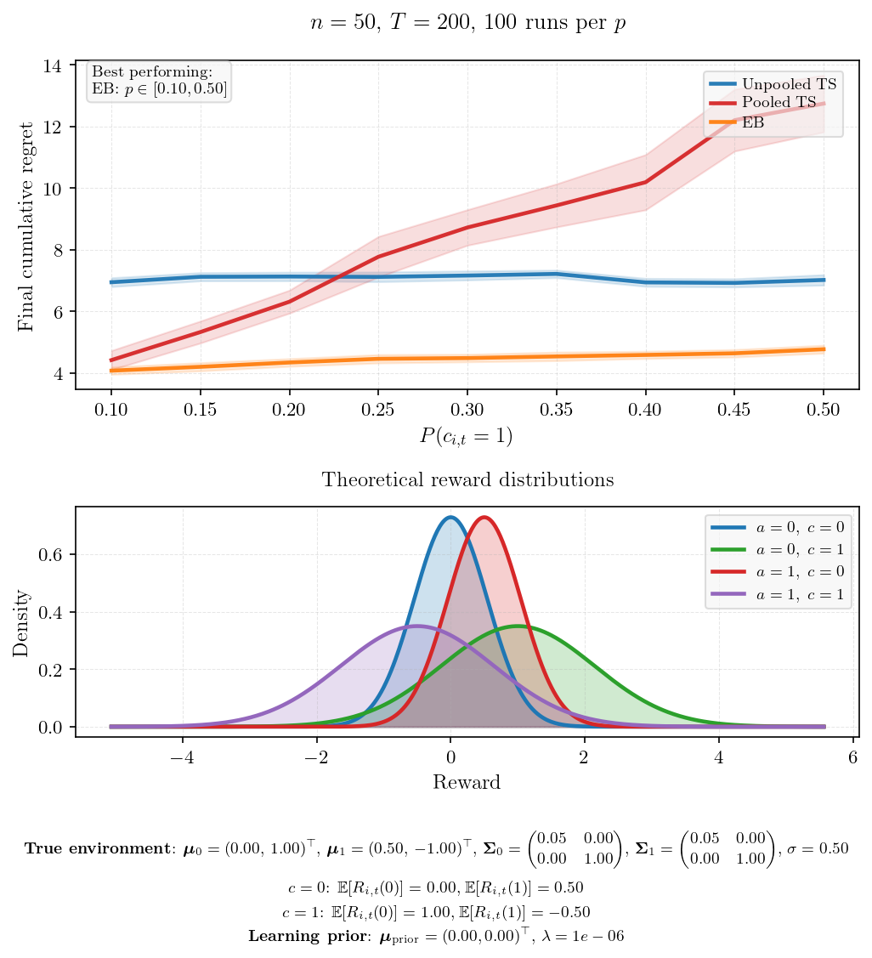
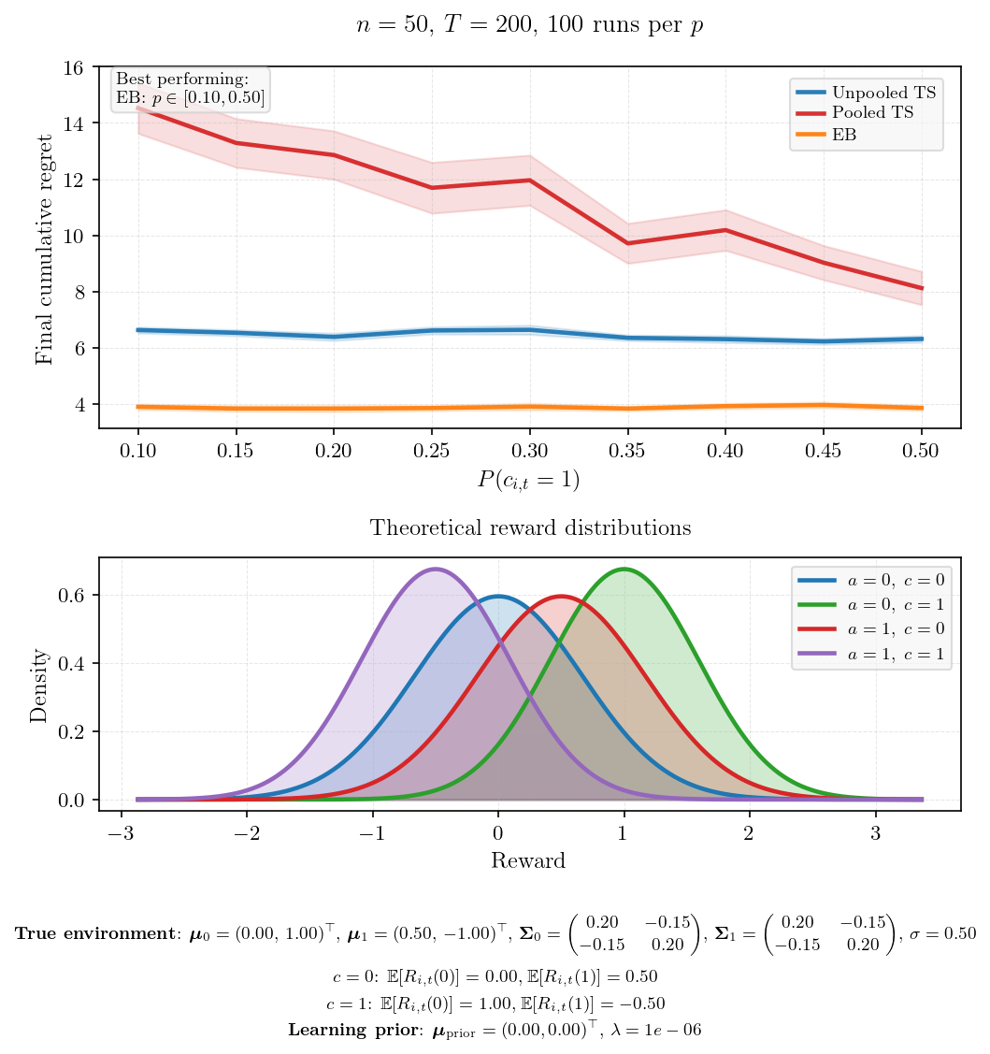
High variance in context coefficient
Correlated intercept and context coefficient

